Slide 1
Applying ACT for Children, Teens & Families
Lisa W. Coyne

Slide 2
Centering Meditation
Notes:
Rumi’s The Guest House

Slide 3
Ways of Being Exercise for Therapists

Slide 4
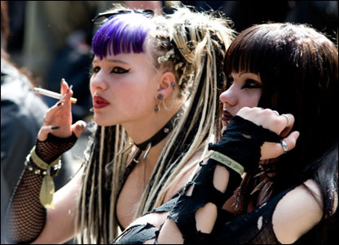

Slide 5
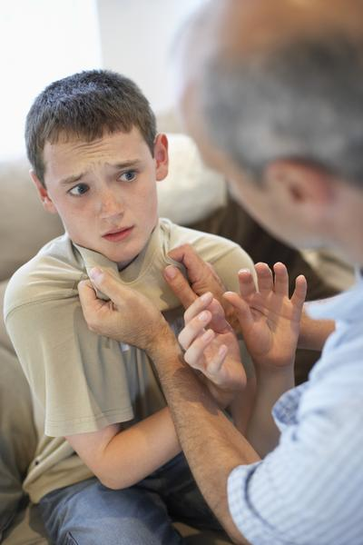

Slide 6
Rules & Pliance

Slide 7

Did you think
to ask these
questions?
When did you stop dancing?
When did you stop singing?
When did you stop being
enchanted by stories?
When did you stop
being comforted by the
sweet territory of silence?

Slide 8
ACT with Kids: Be Curious
Follow Your Heart
You Are Here
Be Curious
Present Moment
Self As Context
Acceptance Defusion
Values
Committed Action

Slide 9
Defusion
Notes:
Mindfulness
Appreciation of experience without evaluation or defense
Contact with the Present Moment
“Showing up”
Acceptance
Allow self to have whole of experience when doing so fosters effective action
NOT simply tolerance
ANYTHING that involves interacting with the aversive event that is not avoidance
Optimally, a wide variety of rich interactions
As different as possible from the usual ways of interacting (functionally, if not formally)

Slide 10
Defusion
Defusion is salience of verbal and nonverbal functions with no one verbal function dominating.
  Elaborative, not restrictive
  Focus on process with content
  Improving tracking by reducing pliance

Slide 11
Let’s Try Something
Volunteer an
  Evaluation
  Judgment
  Reason for something
  Thought
Notes:
Lisa
Write on a piece of paper…
Ask how close is this to you – illustrate the goal of ACT
Do the push/hold exercise
I want you to imagine that this clipboard is all those painful thoughts and feelings you’ve been trying to get rid of for so long, and I want you to place both your hands flat on this clipboard and push against it, trying to get rid of it. You want it all to go away you keep pushing
Notice how much effort and energy it requires – trying to make them go away. You’ve tried distracting yourself with TV, music, computers, books, avoiding friends and family, staying home, avoiding work
You’ve been doing all this painful pushing, but are your thoughts going anywhere?
It’s tiring isn’t it?
And if I asked you, while you were pushing, to cook dinner, go to the zoo with your family, go on a date with your significant other, could you do it?
And I bet it’s even hard to have a conversation with me while you’re pushing
So what would it be like if we just held the clipboard in our laps
All the problems would still be there but there’s less struggle
And you’ve opened up so many more possibilities for doing things that you value

Slide 12
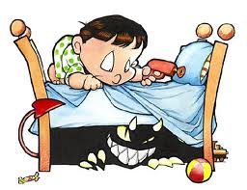
Defusion: Meeting the monster under the bed
Exercise: Let me introduce my friend…

Slide 13

For Emotion Explorers: Monsters on the Boat
Tug of War with a Monster

Slide 14
An Example (Twohig, Hayes & Berlin, 2008)
We are going to play a little game with the thoughts that bother you at school. Usually when the thoughts start to show up, you grab onto them and struggle with them. You get really involved with them. We are going to do something-not to make them go away-but to play with them a little differently. We are going to make paper airplanes and use the thoughts that get in your way as the names for the planes. We will write those thoughts on the side of the planes.

Slide 15
Teenagers and Defusion
All processes overlaid by biological/maturational aspects of puberty and growth
Defusion
  Increasing capacity for abstraction
  Vast range in individual differences PLUS age difference
    a 13 year old compared with an 18 year old

Slide 16
Words do hurt

Slide 17
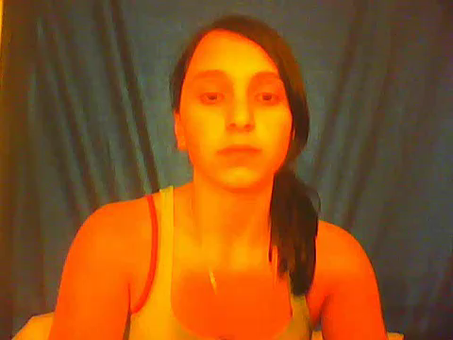

Slide 18
Words do hurt
If you don’t belong, you don’t exist
Zoe, 14 years

Slide 19
From an RFT perspective
Let’s unpack first
Rule: words are real
  The word you wrote = you=real
  That’s pliance
Now you are tracking!
  Noticing actual contingencies in addition to the rule
  Other stimulus functions became available
Transformation of function

Slide 20
Acceptance
Notes:
Allow self to have whole of experiences
When doing so fosters effective action
Does not mean saying “yes” to
Dangerous, unhealthy, or unproductive situations
Does mean saying “yes” to
Thoughts, emotions, memories, history, bodily states, behavioral dispositions
Hopelessness of struggle/control is the problem
Self-compassion and self-forgiveness
Allows our pain to be transient

Slide 21
Acceptance
Involves openly embracing one’s experiences, good and bad, without attempting to change them.
  Alternative: avoidance

Slide 22
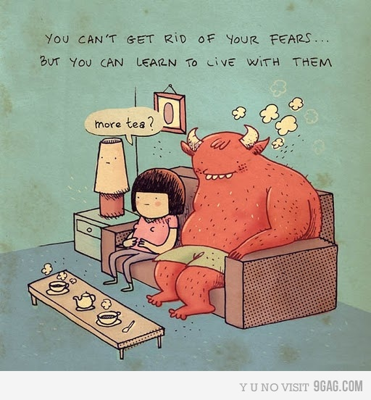

Slide 23

Shipwrecked
Notes:
Useful metaphor that involves the journey

Slide 24
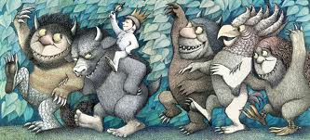
Emotion Adventurers
Invitation to join the expedition
Notes:
What’s in your backpack? Is there a way to tie in that you can’t leave these things behind? Invite them to join the expedition.
Your mind (the book) tells you they are out in the world – but do you ever feel these things now? Then they are here with you.

Slide 25

What Can I Do?
“Stand and Say ‘And’ ” Strategy

Slide 26
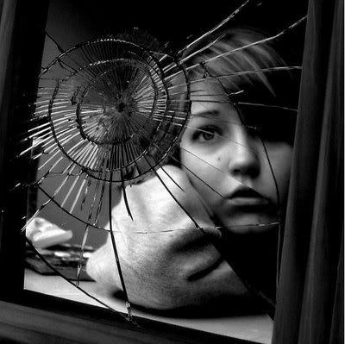
Acceptance for Teens

Slide 27
Acceptance: An Example with Teens (Greco et al. 2008)
See if you can notice, perhaps for the first time, the fact that there is an amazing human being behind those eyes. There is a human being in there who knows what it is like to feel joy and sorrow; who knows what it is like to love and to suffer deeply. At some point, she may even have considered taking her own life to escape all of life’s miseries. And yet, here she is…behind those eyes, looking back at you. See if you can connect with the extraordinary fact that this human being has been with you through it all…the heartaches and sorrows, the happiness and joys. And she’s still here, sitting with you and for you right now. As best you can, try to stay connected and present with this human being, the person behind those eyes. If you find yourself trying to hide or avoid her, then gently, lovingly, lower the shield, take off the mask, and bring yourself back to right here, right now with the human being in the mirror.

Slide 28
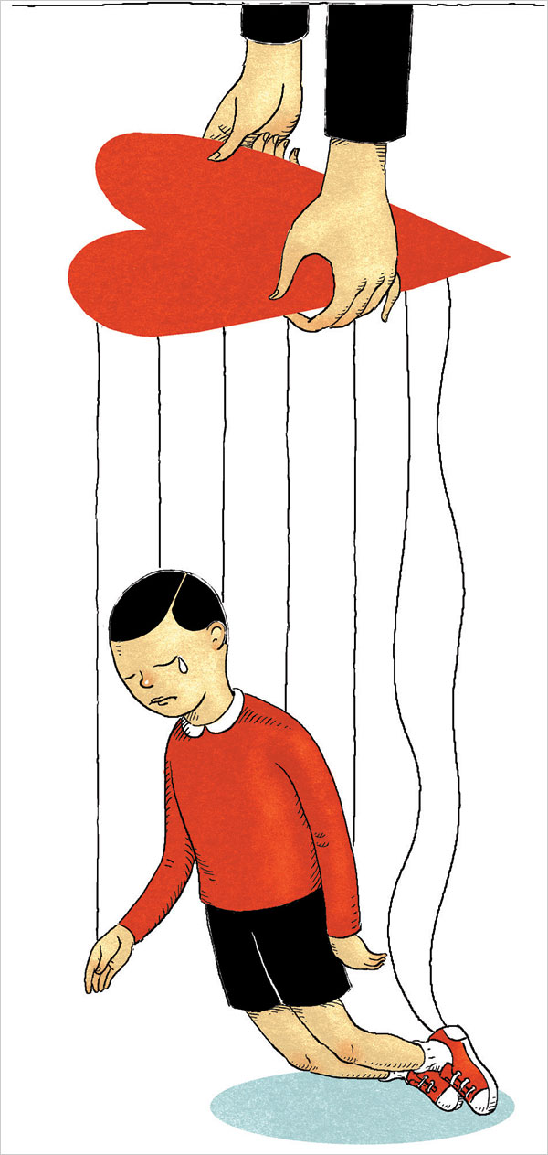

Acceptance for Parents

Slide 29
From an RFT Perspective
Transformation of stimulus functions
  I can have the thought without being the thought
  I can choose to follow the “rule” or not
  The thought doesn’t trigger action as a “have to”

Slide 30
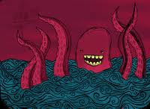
Commitment and Behavior Change Processes
Notes:
Break?

Slide 31
ACT with Kids: Follow Your Heart
Follow Your Heart
You Are Here
Be Curious
Present Moment
Self As Context
Acceptance Defusion
Values
Committed Action

Slide 32
Valuing

Slide 33
If I had only one day left, how would I spend it?

Slide 34

Emotion Adventurers: Making a Compass
Valuing: What do you want your life to be about?
  I want to feel less worried…
  Difference from goal-setting
  Kids and material things
Identifying behaviors that take you in a valued direction
  May only be able to identify
  behaviors that DON’T
Learning the discrimination
  Taught experientially
  If something hurts,
  there’s a value there
Notes:
Shifts the context of the work from aversive to appetitive control. E.g., curing cancer.
Going west vs. going to California. Getting an A vs. being a good student; having Sue as a friend vs. being a good friend
Goal is to help child figure out behaviors that help them to move in a valued direction.
May not know any – leads to creative hopelessness: feels like a struggle or weighting down vs. inspiring – like a balloon is lifting you up.
Experientially: can start with “inspiring situation” or feeling really stuck.

Slide 35
For Emotion
Adventurers:
Making Your Compass
North is:_____________
Things that help me go North:
___________________
___________________
Things that head me South:
___________________
___________________
Notes:
What you really care about?
Tombstone metaphor
Making a collage
What if your intention were true north?
Over the past week?
Does that action head true north?
Is that thought/feeling could give you advice, would the advice head your north?
Being an intention.
If that thought (emotion, bodily state, memory, conversation) could give advice, would the advise head you north?
What advice would the value give right now?
What would you advise someone else to do?
What would you advise your child to do?
Use as material for exposure/defusion

Slide 36
The Bulls' Eye Values Assessment: A Therapeutic Adaptation for Youth
Originally it was an experiential exercise in 'ACT for Kids'; 10-session ACT protocol for young children (Murrell & Wilson, 2002).
Purpose:
  1) helps children identify their values.
  2) measures how consistently children were living in accordance with their values.

Slide 37
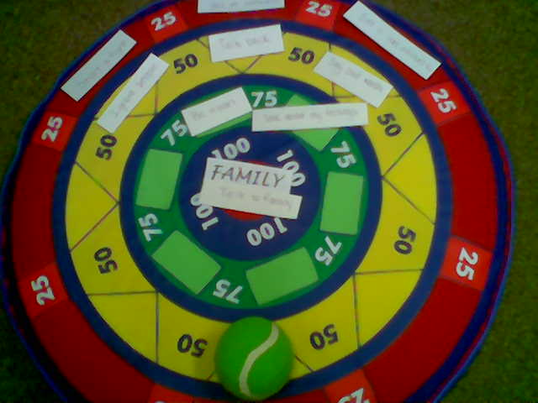
Experiential Bull's Eye
Notes:
VALUES IN PICTURE:
100 center: Family,Talk to family
75 green: Be mean, Talk about my feelings
50 yellow: Ignore people, Talk back, Say bad words
25 red: Yell at someone, Start a fight, Get a bad attitude
Procedure: "past two weeks and the valued
direction. The bull’s eye represents perfect consistency and the consecutive four rings
around bull’s eye represent varying distance from this consistency. The five levels are:
Bull’s eye, very close, close to, in the vicinity, and far from. The dart or X can be placed
anywhere on the board within these levels which best represents how his or her
behavior in the past two weeks coincides with the value life direction."

Slide 38
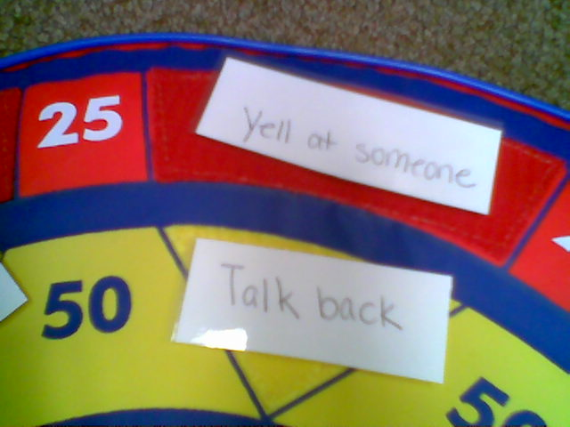

Slide 39

Values for Teens
Values Conversations

Slide 40
Teenagers and Values
Values
  Process that is based on reinforced patterns of activity
  Teens repertoire is narrower
    Less experience, and
    Fewer options
      you can’t leave your home, your parents, your school…..
  Teens have limited life experience
    How do I even know what I care about?
    How do I know who I am?

Slide 41

Developing valuing repertoire
What would you do if you were rich?
And then what?
And then what?
And then?......
-(Shane Curley, South Australia)

Slide 42
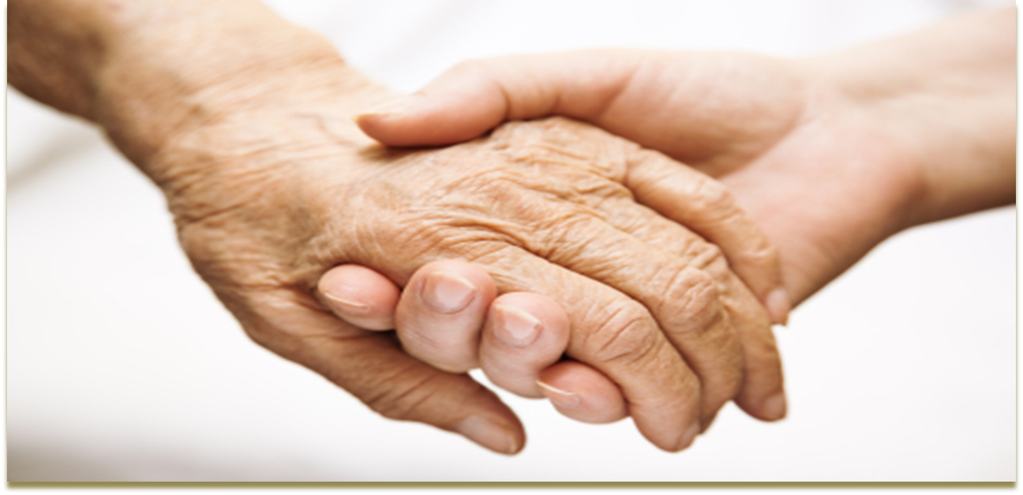
How do you know what you “value”?
If you are willing, I’d like you to try an exercise with me…..
Notes:
EXERCISE
If you are willing….
Close eyes or fixate them towards the ground
Notice 5 sounds in the room
Notice the weight of your legs on the chair
Notice the feeling of your feet making contact with the ground
Now I want you to imagine that through some twist of fate you have died but you are able to attend your funeral in spirit.
You are watching and listening to the eulogies offered by your spouse, your children, your friends, people you have worked with and so. Imagine just being in that situation and get yourself into the room emotionally.
[pause] O.K., now I want you to visualize what you would like these people who were part of your to remember you for. What would you like your spouse to say about you? Have him or her say that. Really be bold here.
Let them say exactly what you would most want her to say if you had a totally free choice about what that would be.
[pause] Now what would you like your children to remember you for, as a parent? Again, don’t hold back. If you could have them say anything, what would it be? Even if you have not actually lived up to what you would want, let them say it as you would most want it to be [pause].
Now what would you like your friends to say about you, as a friend. What would you like to be remembered for by your friends.
Let them say all these things—and don’t withhold anything. Have it be said as you would most want it. And just make a mental note of these things as you hear them spoken. [The therapist may continue with this until it is quite clear the clients have entered into the exercise.
Then the therapist helps the clients to reorient back to the session, e.g., “just picture what the room will look like when you come back and when you are ready just open your eyes.”

Slide 43
An RFT Explanation
Valuing is a motivative augmental
  Contacting a value changes the value of a consequence (again, transformation of function)
  Pursuing them brings one into contact with the things they care about

Slide 44
Willingness and Committed Action

Slide 45

Willingness & Commitment
Behavior Change Processes
  Making life about living values
  Not about eliminating pain
  Pursuing values brings child into contact with fears
Notes:
Commitment exercise.

Slide 46

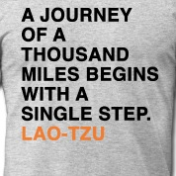
Making a Commitment

Slide 47
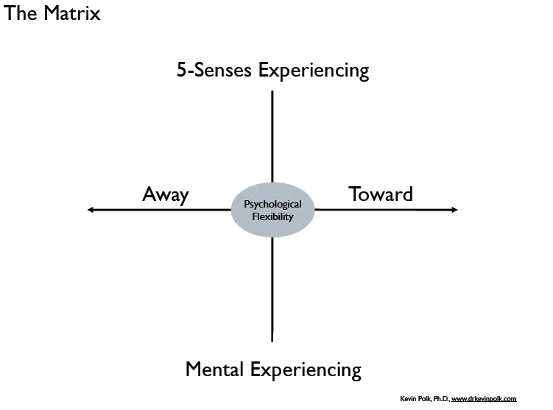
Notes:
ACT is about teaching two discriminations – Present Moment/Mind & Approach/Avoidance

Slide 48
Committed Action: Building Your Expedition Team
Public commitment (to friends, family, etc.) a key component of behavior change
Asking for help: establishment of a collateral contract
  Can be done with parents or kids (team building)
Connecting current decisions to values
  Menu of choices in the moment
  Probable results of different courses of action
Notes:
Collateral contract
Patient agrees to work on goals/values
Collateral agrees to reinforce positive behaviors and not to bring up past problems
Some reminders of problems/nagging can be very triggering
Decision-value connection
Recognizing how choices connect with outcomes (a challenge in real-time)
48

Slide 49
Team Building Worksheet
1. Approach the person you would like to recruit.
2. State your intention (e.g., being an extraordinary student, a good friend, etc.).
3. Acknowledge the person’s skepticism if they knew him from the previous year. For example: “I know this sounds kind of impossible, and I don’t expect you to believe me just yet, but I intend to be an extraordinary student this year.”
4. Repairing damaged relationships where necessary. For example: “I realize that I behaved very badly in your class last year. I know that my behavior was disrespectful. I know that I made it impossible for you to teach me anything.”
5. Finally, ask the individual to be on your team. For example: “I know that to do this, I will need a lot of help. I am building a team to help me be an extraordinary student. Would you please be on my team and help me to be an extraordinary student this year?”

Slide 50
ACT in Practice

Slide 51
A Challenge: Thinking On Your Feet

Slide 52
Teaching ACT Skills
What is it like to feel lost?
What is it like to hold a tool, and use it poorly? Or to not know how to use it?
What is it like not to know what comes next?
What is it like not to know if something will work?
Notes:
Get stuck in explaining. Use “let’s see what happens” and practice accepting whatever shows up

Slide 53
Role Play: Showing Rather than Telling
Young child “I don’t get it”
  Defusion exercise
Teen “This is stupid. Why should I bother doing it?”
  Present moment awareness
Parent “That’s great, but I just need to know how you are going to fix him.”
  Self as Context
Notes:
Helps with “I don’t get it” (young child)
Helps with “This is stupid” (teen)
Helps with “But I just need to know what to do to fix him” or impatience to get to tools to alleviate the problem (which although topographically look like they are adaptive, may actually be experiential avoidance in disguise)

Slide 54
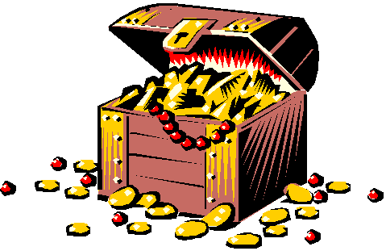
What if painful feelings are like a treasure chest?
And if you look inside, it can tell you what really matters?
Notes:
Experiential Exercise: Approaching a painful thing

Slide 55
Children, Teens, Parents and Emotions
The curious paradox is that when I accept myself just as I am, then I can change.
Carl Rogers
The importance of modeling
Notes:
What shows up in values work: therapist vulnerability and trying to be the “right way” in session – too much emotion/too little emotion
Responding to child’s emotion. Children look to adults to figure out what to do with emotion. They may respond in different ways

Slide 56
An invitation to step into a space….
What is it like to be in the room with your client?
What is it like to see ?
What is it like to be seen?

Slide 57
Role Play: Vulnerability & Values
Younger child: “I am constantly bullied. I am no good.”
Teen: “I want to die.”
Parent: “I lost my temper and spanked him. He just needs to get over it.”

Slide 58
Case Illustration
11 year old European American female
Presenting Problems:
  Benign Rolandic seizures
  “Anxiety”
  Bullied at school
  Social isolation
  Inappropriate social behaviors

Slide 59
Where do you start?

Slide 60
Assessment
Unstructured clinical interview, ADIS-PC, CBCL-TR
Functional Assessment of client behavior as reported at home and at school, as well as observed in session
Assessment of skills vs. performance deficit
AND…what is the stuff you care about? What gets in the way of that?

Slide 61
Developing a Values-Based Therapeutic Contract
Core direction for treatment: What is it you care most about?
Things to listen for and “unpack” via functional analysis:
  I want to switch schools
  I want the bullies to like me/stop being bullied
  I want kids to stop leaving me out
  I want to feel less sad and lonely and worried and embarrassed
  You need to fix me so I can have friends and feel less sad
  There’s something wrong with my brain (seizures)
  I know you can do it because you’re a great therapist
What value ties these all together?

Slide 62
Our Contract
I want to make and keep friendships where people see me and love me just as I am
I want to be a good friend to other kids
VERY IMPORTANT: Value is NOT to make friends to reduce loneliness/sadness/worry embarrassment/isolation
  Such goals ALREADY organize client’s behavior in unhelpful ways
We “stand for” this contract with integrity

Slide 63
Acceptance/Mindfulness Processes
Present Moment Awareness
  Brings child into contact with actual contingencies (RFT term is “tracking”)
Defusion
  Deliteralizing thoughts
  Goal is change in psychological function of thoughts rather than their content
Acceptance
  Approach vs. avoidance
Self-as-Context (perspective-taking)
  I-here-now vs. I-there-then
  If I were a bully, and the bully were me
Notes:
Introduction Exercise:“This is the biggest loser I’ve ever met.” “This is my therapist who is an idiot and is not helpful at all

Slide 64
More Acceptance/Mindfulness-Based Processes
Defusion (Exposure to avoided internal experiences to “deliteralize” thoughts. Goal is change in psychological function of thoughts rather than content)
  “This is the biggest loser I’ve ever met.” “This is my therapist who is an idiot and is not helpful at all

Slide 65
Behavior Change Processes
Valuing (inherent in the therapeutic contract; discrimination training about when one acts values-consistent way vs. struggles)
  Using Your Compass
Willingness (engendering an acceptant posture/openness/compassionate awareness of experience)
  What if …
Committed Action (Identifying steps to take – experientially, didactically)
  Going “North”
Skills training
  Role-plays

Slide 66
Target Behaviors: Skills Training + Defusion
Responding to bullying: The “And?” exercise
Initiating conversations/peer entry skills
Being alone/being lonely
Socially appropriate behaviors
Asking for playdates, even after rejection
Discriminating between healthy vs. unhealthy friendships
Appreciating self in a non-evaluative, compassionate way

Slide 67

Values & Commitment:
Walking the Line
There Be Monsters!
Experiential Avoidance
Valued Direction
Whenever one moves in a valued direction,
avoided experiences show up!

Slide 68
The Secret?
Experiential Avoidance
Valued Direction

Slide 69
Assessment of Progress
Behavioral flexibility
  “I feel powerful!”
Willingness to experience
  “Can we do it again?”
Committed Action
  Approaching feared situations in the service of one’s values
Symptom reduction/exacerbation
  Congratulations – you are human!

Slide 70
Case Conceptualization
17 year-old European American female diagnosed with OCD transferred from another therapist trained in CBT for OCD
CBT + Sertraline for 5 months
ACT + CBT + Sertraline for 4 months
Onset of symptoms: 7th grade

Slide 71
Symptoms at Initial Intake (CBT + Sertraline)
Compulsions | Obsessions
Handwashing | Fear of sexual assault
Washing after toileting | Fear of pregnancy through contact with sperm
Retyping | Harm to others due to failure to wash hands
Checking locks | Car accident if taking indirect route
Arranging/symmetry | Physical aging/wrinkles

Slide 72
Symptoms at Transfer (CBT + ACT + Sertraline)
Compulsions | Obsessions
Handwashing | Fear of sticky residue (sperm)
Washing after toileting | HIV/AIDS
Changing contaminated clothes | Getting pregnant
Checking locks | Rape
Checking to ascertain harm to self/others | Harming self/others

Slide 73
Course of Treatment
22 Sessions: CBT + Sertraline
13 Sessions: CBT + ACT + Sertraline
  Session 1: Building rapport through identifying what client wants and what she has tried (workability)
  Sessions 2 – 5:
    Reconstructing symptom hierarchy
    Exploring broad functions of OCD in client’s life
  Sessions 6 – 7: Identifying client values
  Sessions 8 – 11: Incorporating mindfulness techniques/exercises into E/RP tasks
  Session 12: More explicit defusion techniques to assist with relapse prevention
  Session 13: Commitment to act consistently with valued directions
Sessions 3 – 12: In-session E/RP conducted/Between-session E/RP homework assigned

Slide 74
Between-Session E/RP across CBT and CBT+ ACT Therapy Conditions
Notes:
Note: Sessions 3 – 21 are CBT + sertraline; where numbers restart at 3 – 9, that indicates ACT + CBT + Sertraline

Slide 75
Discomfort Ratings During CBT + ACT E/RP Tasks

Slide 76
Latency of Discomfort Extinction in Between-Session E/RP Tasks

Slide 77
At 5-Month Follow Up…
CYBOCs Severity Score at 5 month follow-up: 7 (Subclinical)
Client was accepted into college of choice
College application included a personal essay detailing her experience with OCD
Meaningful developmentally-appropriate relationship with boyfriend
Considering leading OCD support group for adolescents at local hospital
Gradually discontinuing sertraline

Slide 78
Case Conceptualization
8 year-old girl with OCD/Depression/ODD
  Obsessions: Germ fears, bodily wastes, bodily smells, body dysmorphia
  Compulsions: Spraying, washing, avoiding specific individuals
  Functional impairment: No friends, bossy to peers, suicide threats, physical aggression to parents, often substantially late or misses school
  Parents: “Have given up,” discipline entirely coercive and punitive

Slide 79
Some final thoughts for you…

Slide 80
What if you could make an extraordinary difference in your clients’ lives?

Slide 81
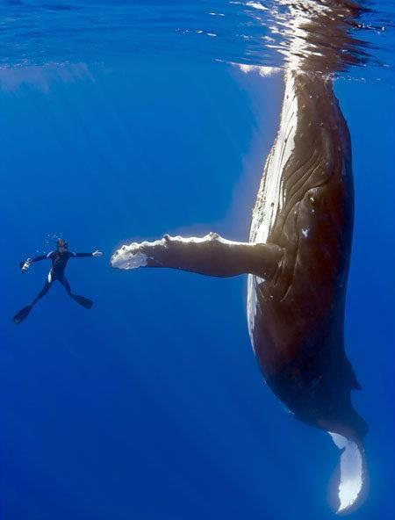
When she was free, the divers say
she swam in what seemed like
joyous circles. She then came back
to each and every diver, one at a time,
and nudged them, pushed them
gently around as she was thanking them.
Some said it was the most
incredibly beautiful experience
of their lives. The guy who cut the rope
out of her mouth said her eyes were
following him the whole time, and he
will never be the same.
Notes:
Recent headline of the San Francisco Chronicle.
Female humpback whale who had become entangled
in a spiderweb of crab traps and line weighted down
by hundreds of pounds of traps that caused her
to struggle to stay afloat. She also had hundreds
of yards of line rope wrapped around her body, tail,
Torso, and a line tugging in her mouth.
A fisherman spotted her just east of the Farallon Islands
and radioed an environmental group for help.
Within a few hours, the rescue team arrived
and determined that she was so bad off,
the only way to save her was to dive in
and untangle her. They worked for hours
and eventually freed her.

Slide 82
May you, and all those you love, be so blessed and fortunate
to be surrounded by people who will help you get untangled
from the words and stories that are binding you.
And, may you always know
the joy of giving and receiving gratitude.

Slide 83
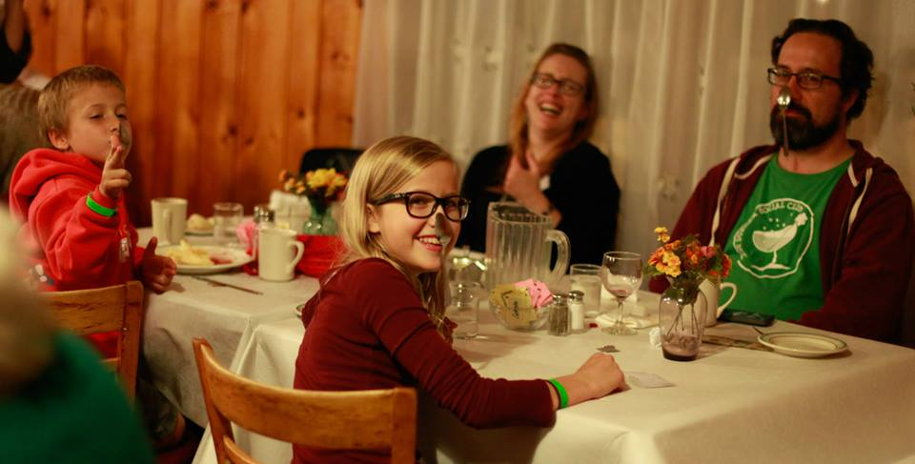
Namaste
For more resources,
please contact:
Lisa W. Coyne, Ph.D.
Harvard Medical School/Mclean
Email: lcoyne@partners.org
Thank You!

